Slide 1
asp.net core系列
Entity Framework Core
桂素伟

Slide 2
大纲
Entity Framework Core
EF Code First
案例Demo:EF for SqlServer & EF for Sqlite
Dapper

Slide 3
Entity framework core
https://docs.microsoft.com/zh-cn/ef/core/
EF Core2.0高性能注意事项：
services.AddDbContextPool<BloggingContext>( options => options.UseSqlServer(connectionString));

Slide 4
Entity framework core-code first
程序包管理控件台
Install-Package Microsoft.EntityFrameworkCore.SqlServer
Install-Package Microsoft.EntityFrameworkCore.Tools
Install-Package Microsoft.VisualStudio.Web.CodeGeneration.Design

Slide 5
Entity framework core-code first
从数据库生成Model
Scaffold-DbContext “Server=.;Database= TestManageDB;Trusted_Connection=True;” Microsoft.EntityFrameworkCore.SqlServer -OutputDir Models/DataModels

Slide 6
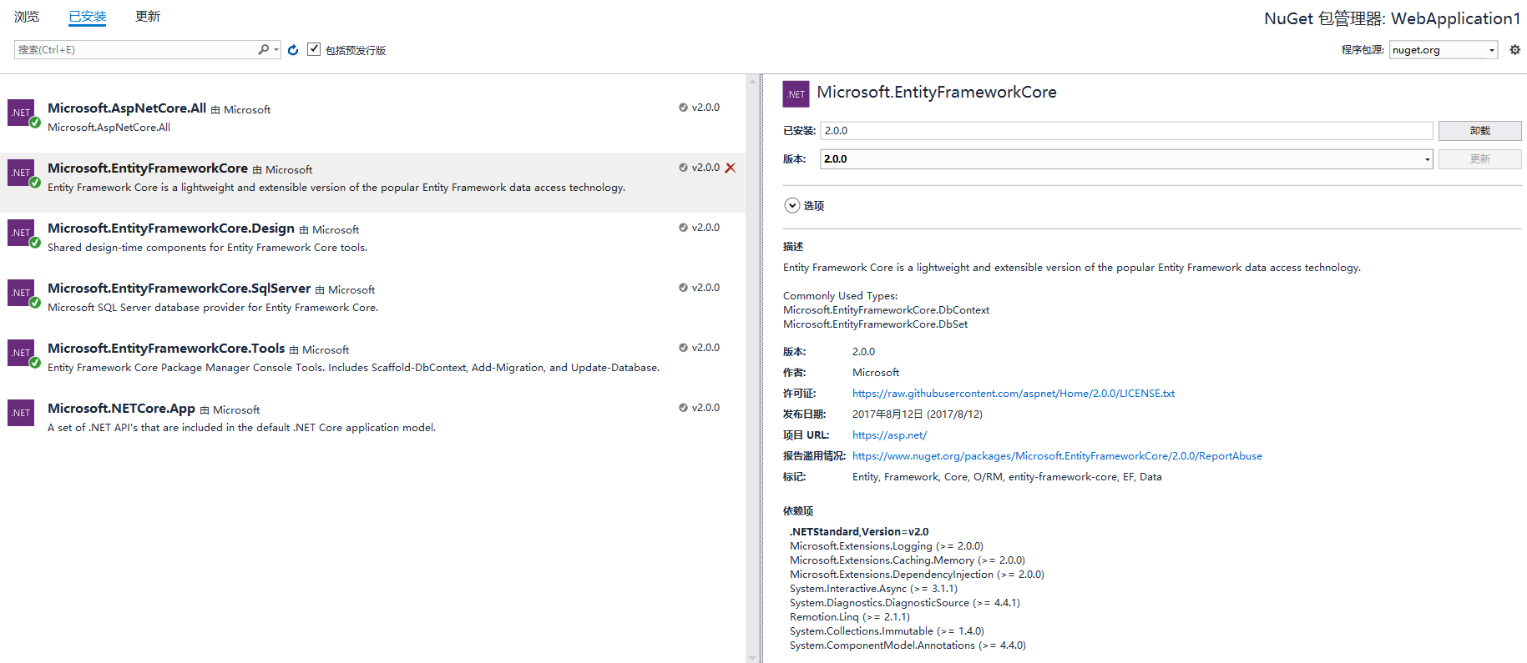
Entity framework core-code first

Slide 7
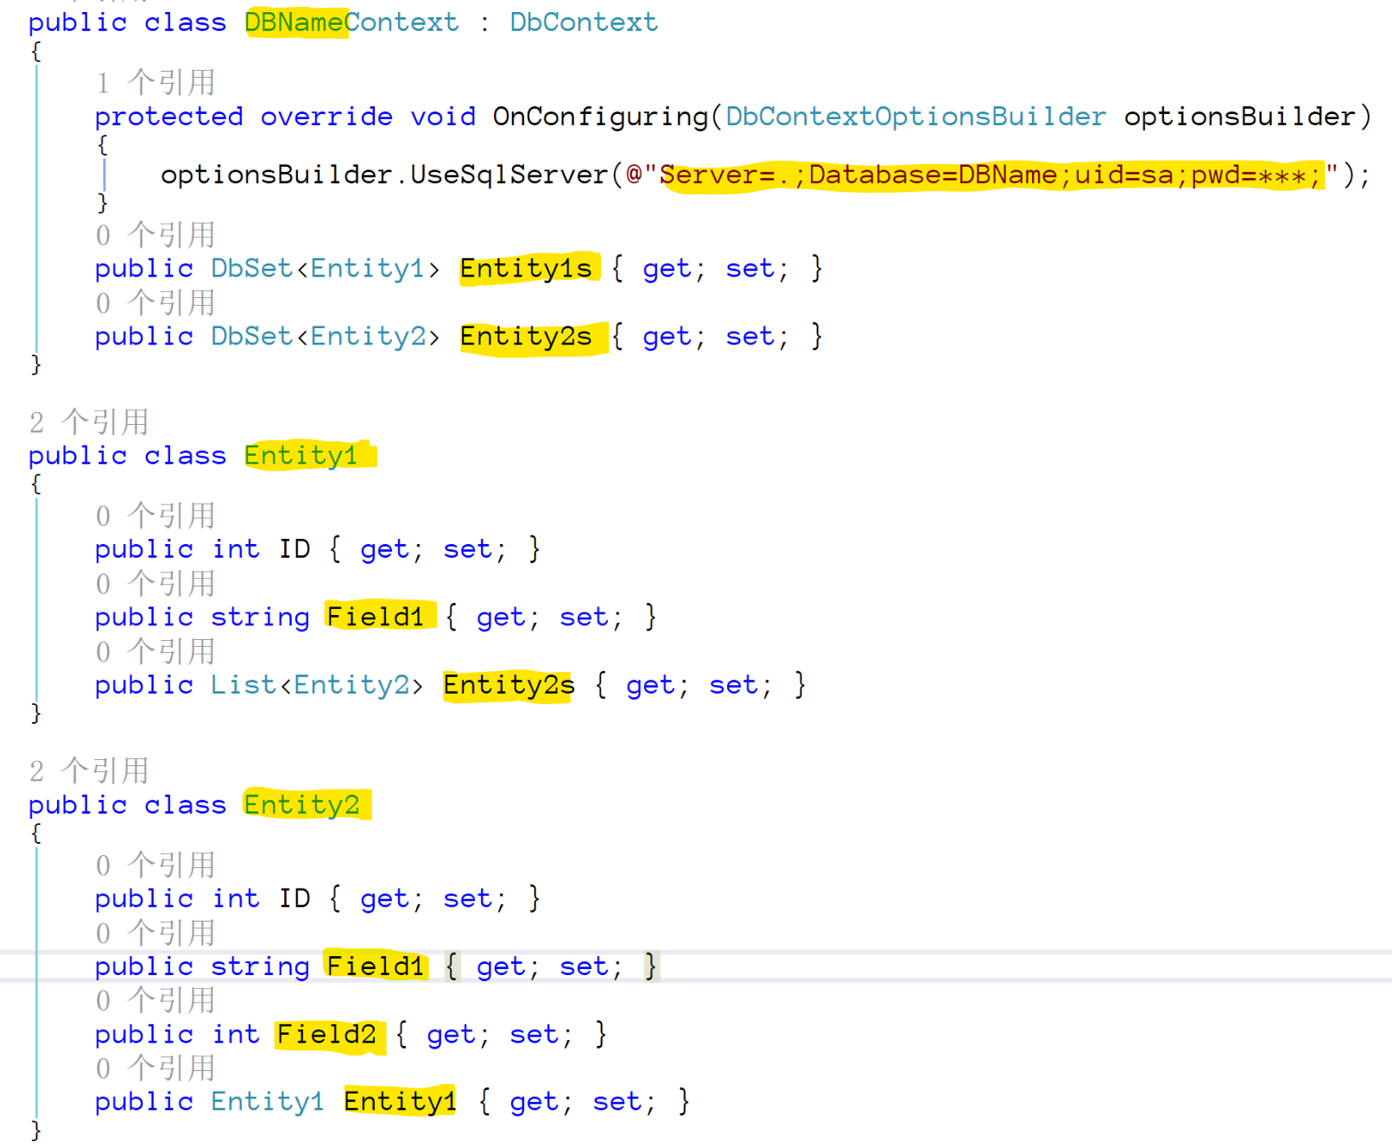
Entity framework core-code first

Slide 8
Entity framework core-code first
从Model生成数据库
注：一定要Build，然后再使用code first命令
Add-Migration MyFirstMigration
Update-Database
Notes:
http://www.cnblogs.com/artech/archive/2016/05/18/5507092.html

Slide 9
Entity framework core并发
并发令牌
特性方式：
[ConcurrencyCheck]
API方式：
protected override void OnModelCreating(ModelBuilder modelBuilder)
{
modelBuilder.Entity<UserTable>()
.Property(p => p.UserName)
.IsConcurrencyToken();
}
Notes:
http://www.cnblogs.com/artech/archive/2016/05/18/5507092.html

Slide 10
Entity framework core并发
时间戳：
protected override void OnModelCreating(ModelBuilder modelBuilder)
{
modelBuilder.Entity<Answers>(entity =>
{
entity.HasIndex(e => e.QuestionId)
.HasName("IX_QuestionID");
entity.Property(e => e.Id).HasColumnName("ID");
entity.Property(e => e.TimeSpan).IsRowVersion();
entity.HasOne(d => d.Question)
.WithMany(p => p.Answers)
.HasForeignKey(d => d.QuestionId)
.HasConstraintName("FK_dbo.Answers_dbo.Questions_QuestionID");
});
}
Notes:
http://www.cnblogs.com/artech/archive/2016/05/18/5507092.html

Slide 11
Demo
EF for SqlServer
——《考试系统》
EF for Sqlite
——《工作记录系统》
Notes:
http://www.cnblogs.com/artech/archive/2016/05/18/5507092.html

Slide 12
其他ORM
Dapper:一个轻量级的ORM
https://github.com/StackExchange/Dapper
Notes:
http://www.cnblogs.com/artech/archive/2016/05/18/5507092.html

Slide 13

Thank You!

